Slide 1

ECE 530 Cloud Computing
Ioannis Papapanagiotou
SQL vs NoSQL

Slide 2
Storage: Primary Requirement
One of the main things we need in any cloud computing environment is the ability to interact with some form of data storage – airline reservations, bank accounts, scheduled pizza deliveries

Slide 3
Scalability: The Primary Design Goal
We moved to the cloud in order to scale. If we didn’t care about scaling, we wouldn’t have gone to the cloud.
Our cloud application’s data handling has to scale well. If it doesn’t, then the cloud’s computational scalability gets bottlenecked into uselessness.

Slide 4
What is SQL?
Structured Query Language
The basic language computers and humans use to chat with relation databases
It can be used to…
– Retrieve data
– Insert new data
– Delete or update data

Slide 5
Are all databases relational?
No, there are many alternative ones. Relational databases mainly use SQL
The last few years, because of the Cloud evolution, there has been a trend towards distributed databases
Optimized for handling items, not fields.
SQL can easily process individual field values for millions of items, but do badly in processing entire records
NoSQL is fast with millions of items, but (relaOvely) bad at retrieving and processing specific field values for large number of items

Slide 6
How does SQL look like?
Let us focus on SELECT:
“SELECT ID, firstname, lastname, city FROM customer”
“SELECT ID, firstname, lastname, city FROM customer ORDER BY city”
“SELECT ID, firstname, lastname, city FROM customer WHERE country = ‘USA’”

Slide 7
Storage Kingdom 1: Non-Relational
Common storage structures include blobs, tables, and queues
There is no consistent interface
they tend to scale very well
Whatever integrity the program requires is the responsibility of the program developer

Slide 8
Storage Kingdom 2: Relational
These are the classic table-based databases such as Oracle and Microsoft SQL Server
They provide data integrity services, such as not allowing a customer to be deleted from the customer table as long as an order in the order table references that customer
Support complex queries involving joins over multiple tables
Harder to scale well, particularly to multiple machines
Often contain legacy data from apps that need to move to cloud

Slide 9
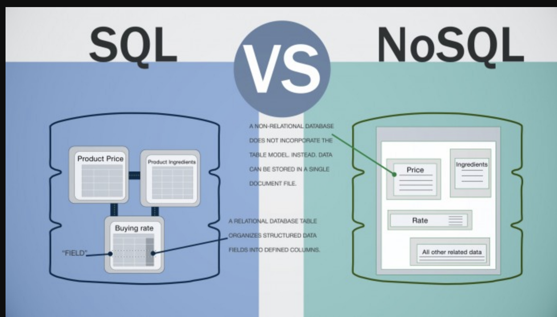

Slide 10
A blog (SQL Example)
Relational Example:
Table for all your posts.
Each post in that table has a row
Row has something like a numeric ID, and the text of that post.
When you want to read a blog post, the URL in that address bar of your says something to the effect of “give me post #1”.
Query: “select everything from the posts table where the ID of the post is 1”.
Response: The post --- the software renders some HTML out of it and sends it back to your browser.
The relational model typically comes into play when you visit a blog that has comments.
That Comments table will most likely have the same ID column, and a column called “body” or something like that for storing the text of the comment.
Notes:
“does that really make sense to store blog posts over here and comments over there? They’re clearly related. When are you ever going to be examining a post’s comments without wanting that post also?”

Slide 11
A blog (SQL Example - cnt’d)
This table will also have a column called something like “post_id”, and what gets stuffed in that column is the ID of the blog post that this comment “relates” to.
So now when your reader comes by, the blog software turns around to the database and asks for two things this time –
Query #1: “select everything from the posts table where the ID of the post is 1”,
Query #2 “select everything from the comments table where the post_id is 1”.
This second “query”, if you’re lucky enough to write something that people respond to, will return a list of comments, an array if you will, that your blog software will then convert to HTML and append to your blog post in the form of the comments section.

Slide 12

A blog (NoSQL example)
Request comes in, blogging software turns around to DB and says “Please give me back this specific post and everything related to it”, in this case a listing of comments.
Since we’re not forced to be too uptight about having to define how the data is structured beforehand, what if we want to tag that post with an arbitrary number of categories?
No problem, stick them on the same document and when blog software says “gimme everything on Post #1”, the tags, the comments, and any other randomly associated data come back with it.
Notes:
Your software doesn’t need to know ahead of time, you don’t need to know ahead of time. It all just kind of works, provided you know what you’re doing on the software level.

Slide 13
Grocery (NoSQL example)
You can model the grocery list in a lot the same way - a piece of paper, you write the items you want on there.
But let’s say, for the purposes of this example, you figure out after a couple of months that you want to keep track of how many loaves of bread you actually bought last year.
Well, with the non-relational model you might literally have to go through every list and count each loaf individually, whereas had you modeled this in a relational way, you could get that count back almost instantly.
Notes:
But, modelled correctly, you’d also have a table in the middle called a “join table” that allows you to associate any number of items with any number of lists. After a while, were you truly the hacker, you could probably write some code that’d predict what you need to put on that list without even having to put it on there yourself, based strictly off of patterns that are easily discernable in a relational database.
http://db-engines.com/en/ranking

Slide 14
SQL vs NoSQL

